Slide 1
-The Bohr Model
-The Quantum
Sikandar Khan

Slide 2
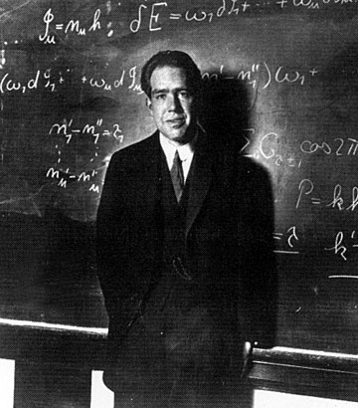
Niels Bohr
(Born in Denmark 1885-1962)
Student of Rutherford

Slide 3
Drawbacks of Rutherford's Model
“A small charged particle moving around an oppositely charged centre continuously loses its energy”.
If an electron does so, it should also continuously lose its energy and should set up spiral motion ultimately failing into the nucleus.
It could not explain the line spectra of H – atom and discontinuous spectrum nature.

Slide 4
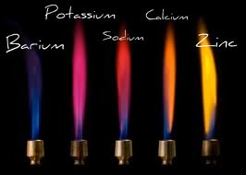
Bohr's Model of the Atom
Niels Bohr (1913):
-studied the light produced when atoms were excited by heat or electricity

Slide 5
Bohr's Model of the Atom
Niels Bohr (1913):
-studied the light produced when atoms were excited by heat or electricity
Rutherford's model couldn't explain why unique colours were obtained by atoms of different elements
Bohr proposed that electrons are in orbits & when excited jump to a higher orbit. When they fall back to the original they give off light

Slide 6
Bohr's Model of the Atom
Bohr's model:
-electrons orbit the nucleus like planets orbit the sun
-each orbit can hold a specific maximum number of electrons
-electrons fill orbits _____ to the nucleus first.

Slide 7
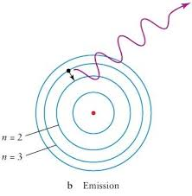
Niels Bohr’s Model (1913)
Electrons orbit the nucleus in circular paths of fixed energy (energy levels).

Slide 8
Max Plank
E=hν
E=energy
ν=frequency
h=Plank’s constant 6.7x10⁻³⁴Js

Slide 9
Energy of Emitted Photon
Energy of the emitted photon =
Difference in energy between two states

Slide 10
Energy emitted by the electron as it leaps from the higher to the lower energy level is proportional to the frequency of the light wave.
Frequency define the color of visible light.

Slide 11
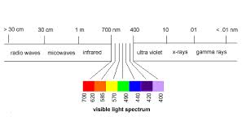
Visible Light Spectrum

Slide 12
Niels Bohr’s Atom Cont’d
Electrons can jump from energy level to energy level.
Electrons absorb or emit light energy when they jump from one energy level to another.

Slide 13
Quantum
A quantum of energy is the amount of energy required to move an electron from one energy level to another.

Slide 14
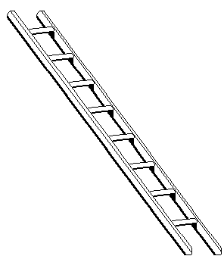
The energy levels are like the rungs of a ladder but are not equally spaced.

Slide 15
Photons
Photons are bundles of light energy that is emitted by electrons as they go from higher energy levels to lower levels.

Slide 16
Excited State and Ground State
Ground state: the lowest possible energy level an electron be at.
Excited state: an energy level higher than the ground state.

Slide 17
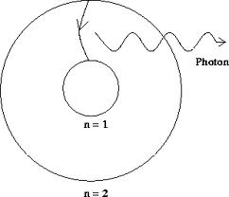

Slide 18
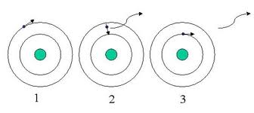
Emission Spectrum
Light emitted produces a unique emission spectrum.

Slide 19
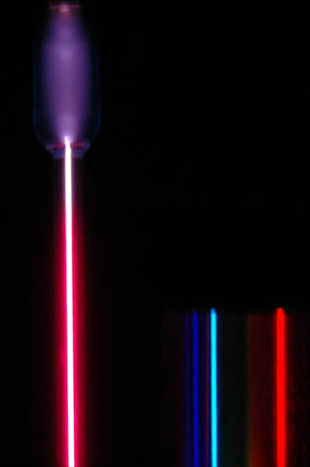
Hydrogen Emission Spectrum
Violet
Blue
Red
Balmer Series

Slide 20
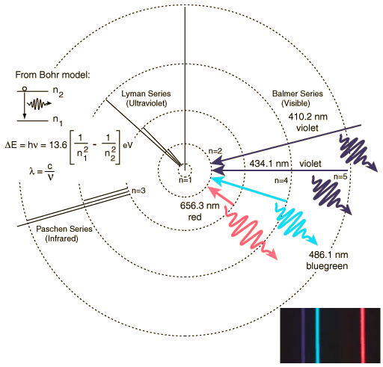
Bohr Model for Hydrogen

Slide 21
Drawback
The Bohr model explained the emission spectrum of the hydrogen atom but did not always explain those of other elements.

Slide 22
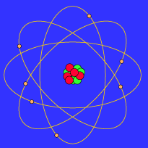

Bohr Model
According to Bohr’s atomic model, electrons move in definite orbits around the nucleus, much like planets circle the sun. These orbits, or energy levels, are located at certain distances from the nucleus.

Slide 23

Wave Model

Slide 24

The Wave Model
Today’s atomic model is based on the principles of wave mechanics.
According to the theory of wave mechanics, electrons do not move about an atom in a definite path, like the planets around the sun.

Slide 25
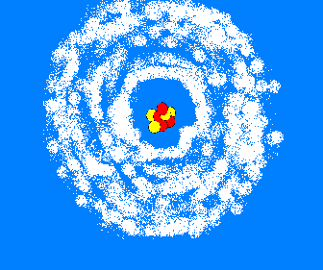
The Wave Model
In fact, it is impossible to determine the exact location of an electron. The probable location of an electron is based on how much energy the electron has.
According to the modern atomic model, at atom has a small positively charged nucleus surrounded by a large region in which there are enough electrons to make an atom neutral.

Slide 26
Electron Cloud:
A space in which electrons are likely to be found.
Electrons whirl about the nucleus billions of times in one second
They are not moving around in random patterns.
Location of electrons depends upon how much energy the electron has.

Slide 27
Electron Cloud:
Depending on their energy they are locked into a certain area in the cloud.
Electrons with the lowest energy are found in the energy level closest to the nucleus
Electrons with the highest energy are found in the outermost energy levels, farther from the nucleus.

Slide 28
